Slide 1


Smart Learning School
Dan Conley
Director of In-School AP

Slide 2
Outline
Metacognition: What and why?
The Origins of Smart Learning School
The Platform & Programme
Students
Tutors / Teachers
Adult Learners

Slide 3
Metacognition:
What & Why?

Slide 4
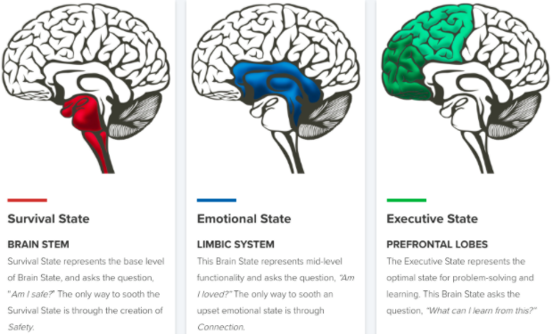
What is Metacognition?
"Thinking about thinking"
A crucial element of effective learning
Awareness / monitoring of cognitive processes
Strategies to regulate our learning
Essential steps:
Establish the foundations of learning
Learn how to select strategies from your toolkit
Improve performance of recall or application

Slide 5

Why Metacognition?
What does the evidence tell us?
The EEF Toolkit

Slide 6
The Origins of Smart Learning School

Slide 7
“You teach psychology - how should I revise?”
“Why can’t I get anything to stick?”
“I did loads of revision and still got a crap grade!”

Slide 8
The Problem
Often students are just told to ‘revise’ for tests
Very rarely does anyone tell them how
How many of us were told how?
Was this part of your teacher training?
Yet it’s 50% of teaching and learning

Slide 9
The Problem (continued)
Tutors and teachers are time poor
Metacognition is complex
Best strategies depend on what you’re learning
There’s lots of quackery & BS out there!
It can’t be last minute in Y11!

Slide 10
The Solution
Start in Y7
Recursive - revisiting themes each year
Fortnightly sessions - 15 mins
No teacher prep / workload
Snappy, relevant, useful
Videos and discussion (not book work)
Pledges for change!

Slide 11
The Platform & Programme

Slide 12

Before, During & After
Essential steps:
Establish the foundations of learning
Learn how to select strategies from your toolkit
Improve performance of recall or application

Slide 13
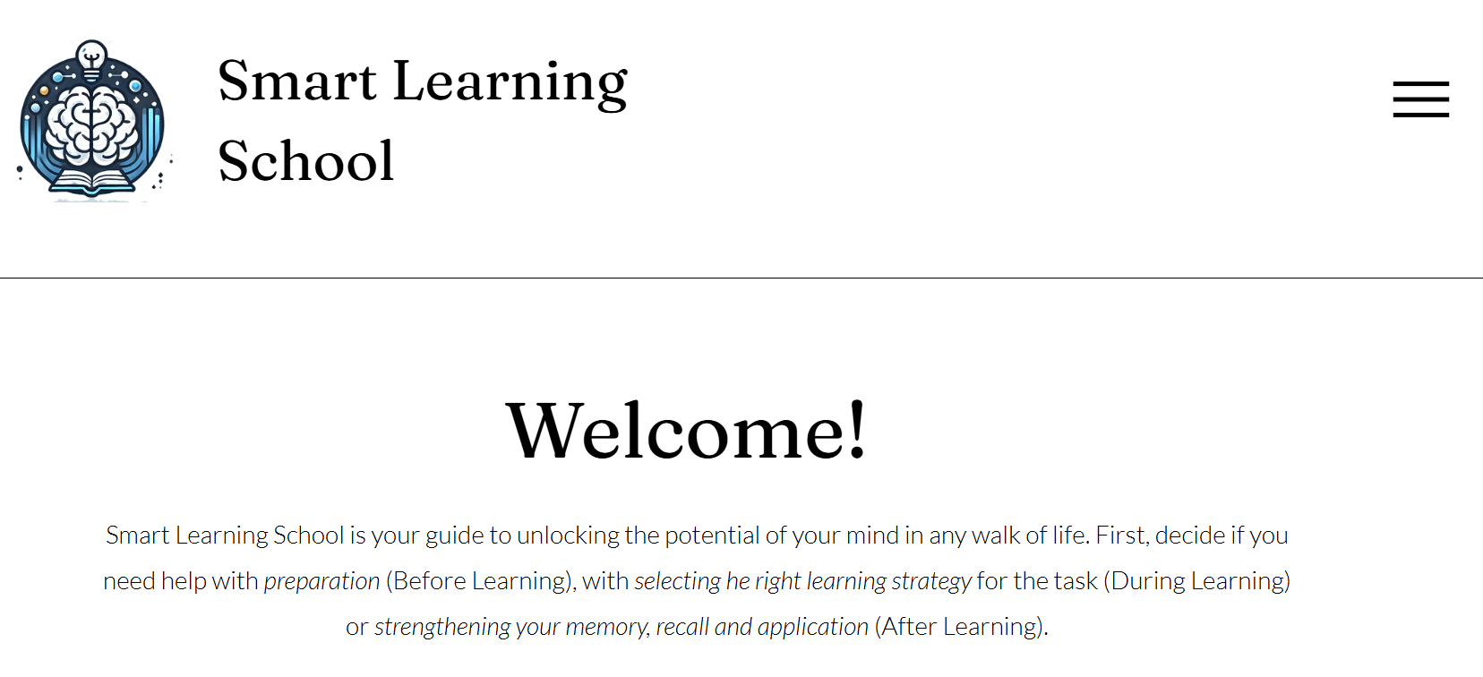
Link here

Slide 14
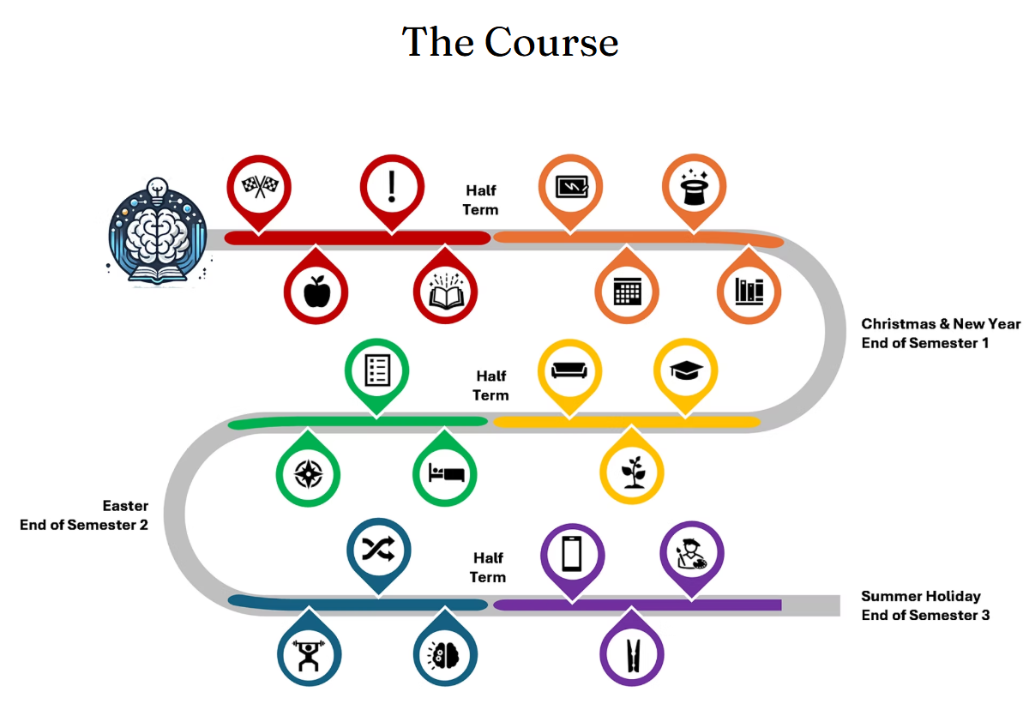
Link here

Slide 15
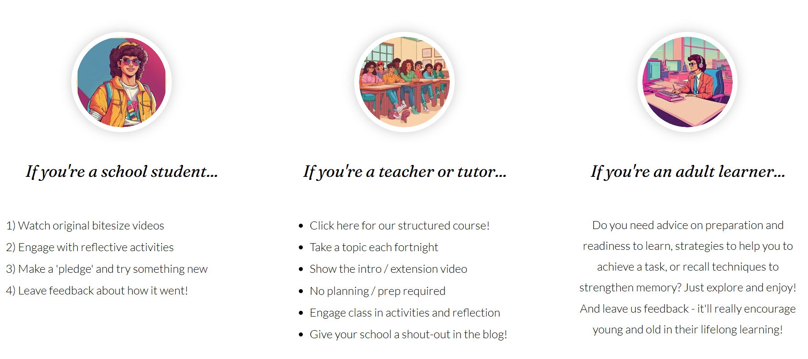

Slide 16
Smart Learning School
Dan Conley
Director of In-School AP
daniel.conley@coopacademies.co.uk
Link here

